Slide 1


Thank you
Lecture 4: Financial Statement Analysis – Part 1
Ratio, Trend, Common-Size, and Industry Comparison Analyses
Presentation to Cox Business Students
FINA 3320: Financial Management

Slide 2
Purpose of This Lecture
Develop tools to analyze financial statements using
  (1) Ratio and Trend Analyses
    Become familiar with constructing and interpreting ratios
    Learn to interpret and analyze trends in ratios
  (2) Comparative Analyses
    Common-Size Analysis: comparison of one company to another
    Industry Comparison Analysis: comparison of one company to the industry average
Notes:
Understanding Media: Extensions of Man, published in 1964.
The medium you use to send a particular message automatically predisposes audience members to make certain tacit assumptions about the message before they even read it.
Put another way, people unconsciously judge books by their covers.
How does this apply to business communications?
If you want to announce cutbacks in your company’s health benefits, don’t deliver the message with a glitzy, over-the-top, no-expenses-spared campaign.
Conversely, if you want to position your company as a leader in innovation, don’t advertise your message on sandwich boards dangling from the necks of ragamuffins traipsing around in front of gas stations.

Slide 3
The Example: Cox Oil Company, Inc.
We will employ the Cox Oil Company, Inc. example throughout
Cox example will illustrate basic financial analysis techniques and procedures
  True test of understanding is ability to apply concepts
  Cox example provides application of each financial analysis
    Makes is easier to ‘reverse engineer’
Notes:
Understanding Media: Extensions of Man, published in 1964.
The medium you use to send a particular message automatically predisposes audience members to make certain tacit assumptions about the message before they even read it.
Put another way, people unconsciously judge books by their covers.
How does this apply to business communications?
If you want to announce cutbacks in your company’s health benefits, don’t deliver the message with a glitzy, over-the-top, no-expenses-spared campaign.
Conversely, if you want to position your company as a leader in innovation, don’t advertise your message on sandwich boards dangling from the necks of ragamuffins traipsing around in front of gas stations.

Slide 4
Ratio and Trend Analysis
Ratio Analysis
Trend Analysis
Du Pont Analysis
Notes:
Understanding Media: Extensions of Man, published in 1964.
The medium you use to send a particular message automatically predisposes audience members to make certain tacit assumptions about the message before they even read it.
Put another way, people unconsciously judge books by their covers.
How does this apply to business communications?
If you want to announce cutbacks in your company’s health benefits, don’t deliver the message with a glitzy, over-the-top, no-expenses-spared campaign.
Conversely, if you want to position your company as a leader in innovation, don’t advertise your message on sandwich boards dangling from the necks of ragamuffins traipsing around in front of gas stations.

Slide 5
Ratio and Trend Analysis
For each ratio, we will discuss four items
  (1) How the ratio is calculated
  (2) An interpretation of the ratio
  (3) Calculation of ratios for Cox Oil Company, Inc.
    Calculate Cox’s ratios for 2007 and 2006
  (4) Discussion of Cox’s ratio trends
    Interpret trend in ratios from 2006 to 2007
Notes:
So let’s look more closely at how this concept applies to internal communications.
When it comes to internal communications, there’s a virtually limitless supply of messages you might have to deliver.

Slide 6
What is a Ratio?
(1) Calculation
  Some number divided by some other number
  Once you divide denominator into numerator, you get a single number (e.g., 3/2 = 1.5)
(2) Interpretation
  How much of something you have (the numerator) per one unit of something else (the denominator)
  Usually expressed as 1.5:1
  Indicates you have 1.5 of something per every 1 unit of something else
Notes:
So let’s look more closely at how this concept applies to internal communications.
When it comes to internal communications, there’s a virtually limitless supply of messages you might have to deliver.

Slide 7
Categories of Financial Ratios
    Liquidity Ratios
  Measures how easily a company can convert assets to cash
    Asset Management Ratios
  Also known as efficiency ratios or turnover ratios
  Measures how productive a firm is at utilizing its assets
    Debt Management Ratios
  Also known as leverage ratios
  Measures how heavily the company uses debt financing
    Profitability Ratios
  Measures the firm’s return on its investments
    Cash Flow Ratios
  Measures coverage and quality of firm’s cash flows
Notes:
After you understand the basic message you need to communicate, you must identify and define the audience or audiences who should receive the message.
When you’re communicating to employees, you have a vast array of audiences to choose from.
Often times, when leaders or managers communicate something internally, they fail to recognize the subtle, and sometimes not so subtle, differences between different groups of employees.
Overlooking this fact can doom your communications effort before you ever begin to put the proverbial pen to paper.

Slide 8
Liquidity Ratios
    Liquidity measures the quality and adequacy of a firm’s current assets to meet its current obligations
    Three ratios in this category include
      (1) Current Ratio
      (2) Quick Ratio
      (3) Net Working Capital Turnover
Notes:
And of course, after you know your message and have defined your audiences, you must select the most appropriate medium for delivering the message to each audience.
Internal media, like audiences, come in all shapes, sizes, and flavors.

Slide 9
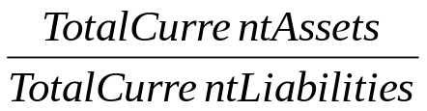
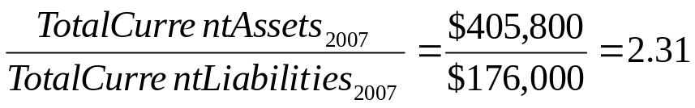
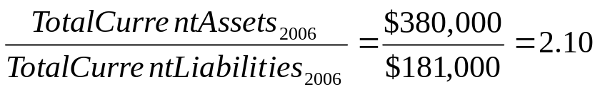
Current Ratio
    (1) Calculation
  Total current assets divided by total current liabilities
    (2) Interpretation
  Rough indication of firm’s ability to service its current obligations
  The higher the current ratio, the greater the ‘cushion’ between current obligations and firm’s ability to pay them
    (3) Cox’s current ratios
    (4) Trend Analysis
  Increasing trend from 2006 to 2007 indicates Cox’s ‘cushion’ increased
Notes:
And of course, after you know your message and have defined your audiences, you must select the most appropriate medium for delivering the message to each audience.
Internal media, like audiences, come in all shapes, sizes, and flavors.

Slide 10
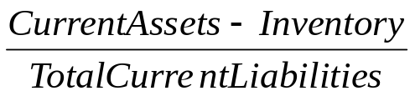
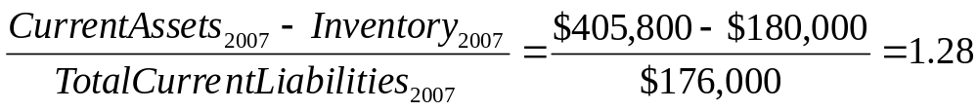
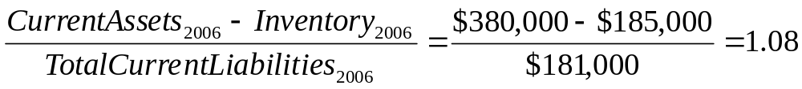
Quick Ratio
    (1) Calculation
  Current assets minus inventory divided by total current liabilities
    (2) Interpretation
  Expresses degree to which company covers current liabilities with its most liquid current assets
    (3) Cox’s quick ratios
    (4) Trend Analysis
  Both years’ ratios greater than one
  Increase from 2006 to 2007 is positive trend
Notes:
And of course, after you know your message and have defined your audiences, you must select the most appropriate medium for delivering the message to each audience.
Internal media, like audiences, come in all shapes, sizes, and flavors.

Slide 11
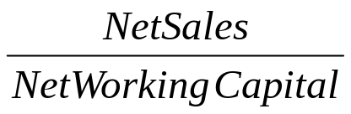
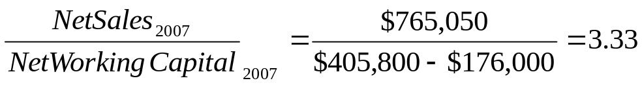
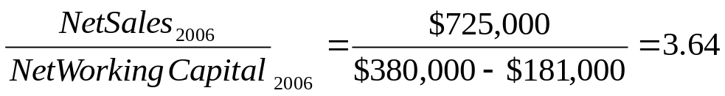
Net Working Capital Ratio
    (1) Calculation
  Net sales divided by net working capital
    (2) Interpretation
  Net working capital is current assets minus current liabilities
  Measures how efficiently net working capital is employed
    (3) Cox’s net working capital ratios
    (4) Trend Analysis
  Indicates $3.33 of net sales generated by each $1 in net working capital
  Decreasing trend from 2006 to 2007 indicates decline in efficiency
Notes:
And of course, after you know your message and have defined your audiences, you must select the most appropriate medium for delivering the message to each audience.
Internal media, like audiences, come in all shapes, sizes, and flavors.

Slide 12
Asset Management Ratios
    Asset management ratios measure how productive the management of a firm is at utilizing the firm’s assets
    Four basic ratios in this category
      (1) Accounts Receivable (A/R) Turnover
      (2) Inventory Turnover
      (3) Fixed Asset Turnover
      (4) Total Asset Turnover
Notes:
And of course, after you know your message and have defined your audiences, you must select the most appropriate medium for delivering the message to each audience.
Internal media, like audiences, come in all shapes, sizes, and flavors.

Slide 13
Asset Management Ratios continued…
    A/R and Inventory utilization measured in two ways
  (1) Turnover Ratio: measures the number of times A/R or inventory is turned over each year
  (2) Days’ On Hand (DOH): measures the average number of days A/R or inventory are on hand
      Both ratios provide the same information, but in different forms
      For Example, if A/R turnover is 4.055X, then A/R DOH is 90 days
    Different industry benchmarks measure inventory turnover differently
  RMA Annual Statement Studies: Cost of goods sold divided by inventory
  S&P Industry Surveys: Net sales divided by inventory
      RMA is theoretically correct!
Notes:
And of course, after you know your message and have defined your audiences, you must select the most appropriate medium for delivering the message to each audience.
Internal media, like audiences, come in all shapes, sizes, and flavors.

Slide 14
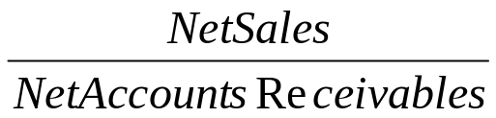
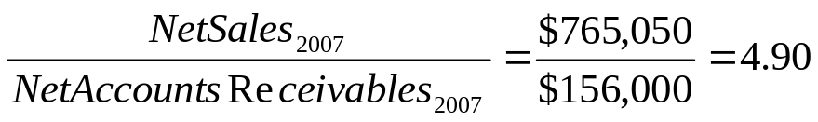
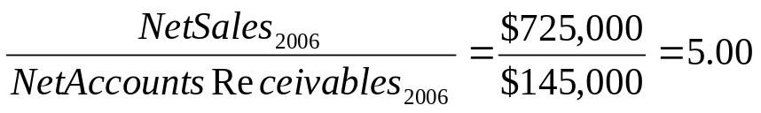
A/R Turnover
    (1) Calculation
  Net sales divided by net A/R
    (2) Interpretation
  Measures the number of times A/R is turned over each year
  Greater the turnover, the shorter the time between sales and cash collection
    (3) Cox’s A/R turnover ratios
    (4) Trend Analysis
  Decline from 5X in 2006 to 4.9X in 2007 indicates Cox is taking longer to collect it’s A/R, which should be investigated!
Notes:
And of course, after you know your message and have defined your audiences, you must select the most appropriate medium for delivering the message to each audience.
Internal media, like audiences, come in all shapes, sizes, and flavors.

Slide 15
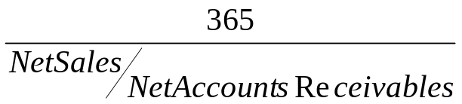
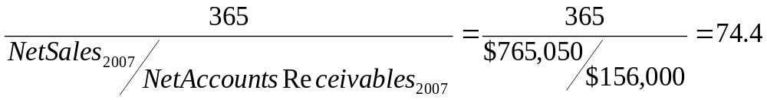
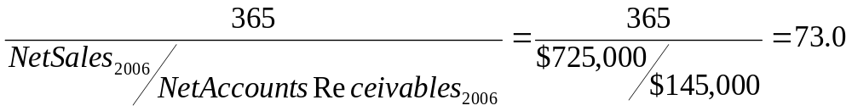
A/R Days-on-Hand
    (1) Calculation
  A/R turnover ratio divided into 365 (number of days in one year)
    (2) Interpretation
  Measures the number of days it take to collect A/R
  Greater the number of days, the greater the probability of delinquencies
    (3) Cox’s A/R DOH ratios
    (4) Trend Analysis
  Increase from 73 days in 2006 to 74.4 days in 2007 indicates Cox is taking longer to collect it’s A/R, which, again, should be investigated!
Notes:
And of course, after you know your message and have defined your audiences, you must select the most appropriate medium for delivering the message to each audience.
Internal media, like audiences, come in all shapes, sizes, and flavors.

Slide 16
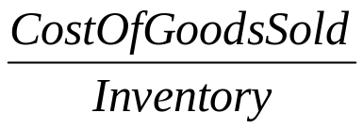
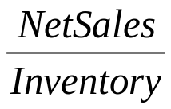
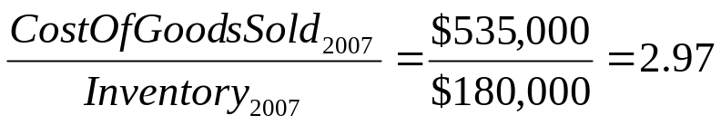
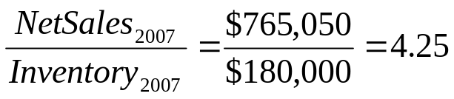
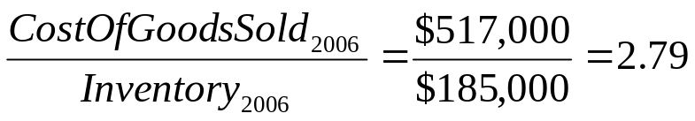
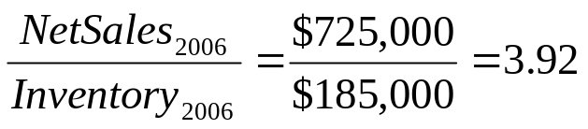
Inventory Turnover
    (1) Calculation
  Cost of goods sold (or net sales) divided by inventory
    (2) Interpretation
  Measures the number of times inventory is turned over each year
  Greater the number turns, the shorter the time that inventory sits on the shelf
    (3) Cox’s Inventory turnover ratios
    (4) Trend Analysis
  Increase from 2.79X in 2006 to 2.97X in 2007 indicates inventory is spending less time on the shelf, a positive trend!
Notes:
And of course, after you know your message and have defined your audiences, you must select the most appropriate medium for delivering the message to each audience.
Internal media, like audiences, come in all shapes, sizes, and flavors.

Slide 17
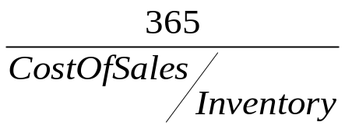
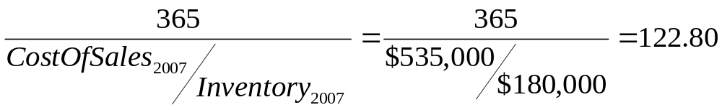
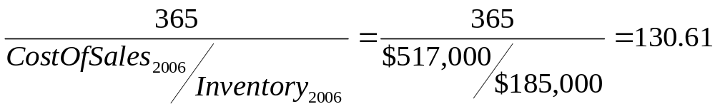
Inventory Days-on-Hand
    (1) Calculation
  Inventory turnover ratio divided into 365 (number of days in one year)
    (2) Interpretation
  Measures the number of days inventory sits on the shelf before being sold
  Provides the average length of time units are in inventory
    (3) Cox’s Inventory DOH ratios
    (4) Trend Analysis
  Decrease from 130.61 days in 2006 to 122.8 days in 2007 represents an improvement and indicates Cox’s inventory spends less time on the shelf!
Notes:
And of course, after you know your message and have defined your audiences, you must select the most appropriate medium for delivering the message to each audience.
Internal media, like audiences, come in all shapes, sizes, and flavors.

Slide 18
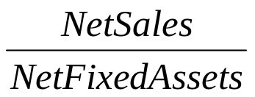
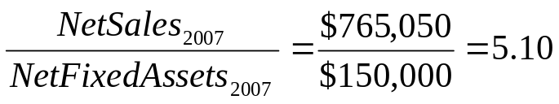
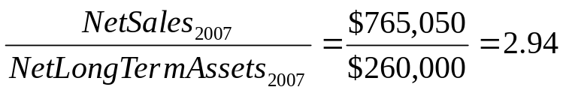
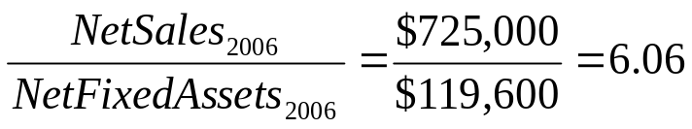
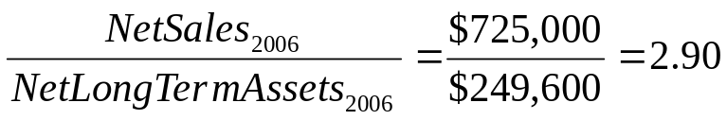
Fixed Asset Turnover
    (1) Calculation
  Net sales divided by net fixed assets (net of accumulated depreciation)
  Dependent on definition of fixed assets (PP&E or Total Long Term Assets)
    (2) Interpretation
  Measures the productive use of a firm’s fixed assets
    (3) Cox’s Fixed asset turnover ratios
    (4) Trend Analysis
  PP&E: Decrease from 6.06X in 2006 to 5.1X in 2007 is a negative trend
  TLTA: Increase from 2.9X in 2006 to 2.94X in 2007 is a positive trend!
Notes:
And of course, after you know your message and have defined your audiences, you must select the most appropriate medium for delivering the message to each audience.
Internal media, like audiences, come in all shapes, sizes, and flavors.

Slide 19
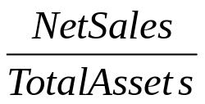
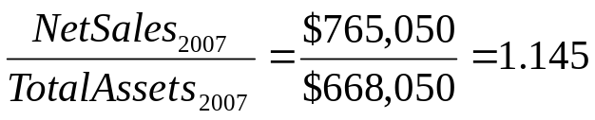
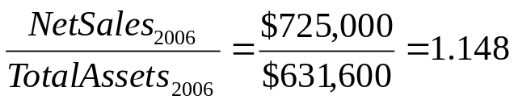
Total Asset Turnover
    (1) Calculation
  Net sales divided by total assets
    (2) Interpretation
  Measures the firm’s ability to generate sales in relation to total assets
  Indicates the number of dollars in net sales generated by each dollar of assets
    (3) Cox’s Fixed asset turnover ratios
    (4) Trend Analysis
  Slight decrease from 1.148X in 2006 to 1.145X in 2007 is a negative trend
  Management needs to focus on underlying reason for this decline!
Notes:
And of course, after you know your message and have defined your audiences, you must select the most appropriate medium for delivering the message to each audience.
Internal media, like audiences, come in all shapes, sizes, and flavors.

Slide 20
Debt Management (Leverage) Ratios
This set of ratios measure the amount of debt used to finance assets
Three basic ratios in this category include
      (1) Accounts Payable (A/P) Turnover
      (2) Debt to Total Assets (also known as Debt Ratio)
      (3) Times Interest Earned (TIE Ratio)
Notes:
And of course, after you know your message and have defined your audiences, you must select the most appropriate medium for delivering the message to each audience.
Internal media, like audiences, come in all shapes, sizes, and flavors.

Slide 21
Debt Management (Leverage) Ratios continued
A/P utilization can be measured in two ways
  (1) Turnover Ratio: measures number of times A/P is turned over each year
  (2) Days’ On Hand (DOH): measures average number of days A/P on hand
      Both ratios provide the same information, just in different forms
      For Example: if A/P turnover is 4.055X, then A/P DOH is 90 days
Different industry benchmarks measure A/P turnover differently
  RMA Annual Statement Studies: Cost of goods sold divided by A/P
  S&P Industry Surveys: Net sales divided by A/P
      RMA is theoretically correct!
Notes:
And of course, after you know your message and have defined your audiences, you must select the most appropriate medium for delivering the message to each audience.
Internal media, like audiences, come in all shapes, sizes, and flavors.

Slide 22
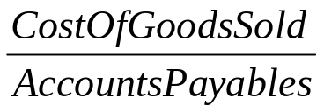
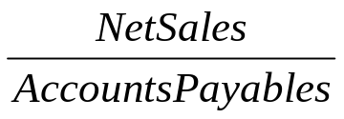
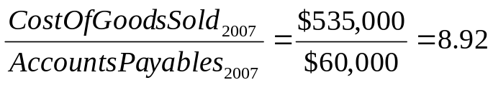
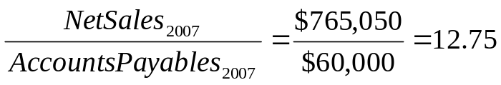


Accounts Payable (A/P) Turnover
    (1) Calculation
  Cost of goods sold (or net sales) divided by accounts payable
    (2) Interpretation
  Measures the number of times A/P turns over per year
  Higher number indicates firm is paying it’s vendors more quickly
    (3) Cox’s Accounts payable turnover ratios
    (4) Trend Analysis
  COGS: Decreased from 9.07X in 2006 to 8.92X in 2007 indicating Cox enjoyed increased trade terms on it’s A/P
  Net Sales: Slight increase from 12.72X in 2006 to 12.5X in 2007
Notes:
And of course, after you know your message and have defined your audiences, you must select the most appropriate medium for delivering the message to each audience.
Internal media, like audiences, come in all shapes, sizes, and flavors.

Slide 23
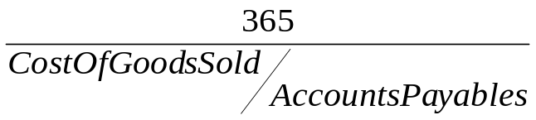
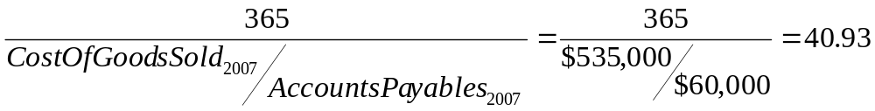
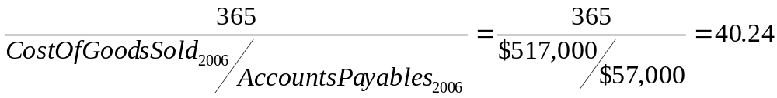
Accounts Payable (A/P) DOH
    (1) Calculation
  A/P turnover ratio divided into 365 (the number of days on one year)
    (2) Interpretation
  Measures the number of days before a firm makes payment to vendors
  Indicates the average length of time a firm’s trade debt is outstanding
    (3) Cox’s Accounts payable DOH ratios
    (4) Trend Analysis
  Slight increased from 40.24 days in 2006 to 40.93 days in 2007 indicating Cox enjoyed increased trade terms on it’s A/P
Notes:
And of course, after you know your message and have defined your audiences, you must select the most appropriate medium for delivering the message to each audience.
Internal media, like audiences, come in all shapes, sizes, and flavors.

Slide 24
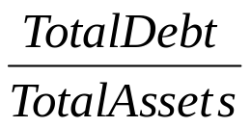
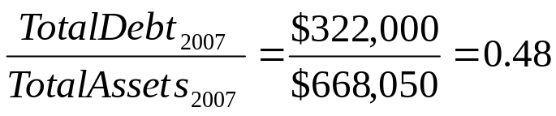
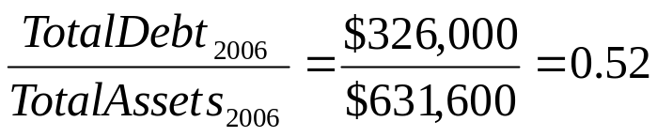
Debt to Total Assets (Debt Ratio)
    (1) Calculation
  Total debt divided by total assets
    (2) Interpretation
  Measures relationship between capital contributed by creditors and total assets, which are financed by both creditors and shareholders
  Amount of debt to each dollar of total assets
    (3) Cox’s Debt to total assets ratios
    (4) Trend Analysis
  Percentage of assets financed by debt decreased from 52% in 2006 to 48% in 2007 indicating Cox de-levered its capital structure
Notes:
And of course, after you know your message and have defined your audiences, you must select the most appropriate medium for delivering the message to each audience.
Internal media, like audiences, come in all shapes, sizes, and flavors.

Slide 25
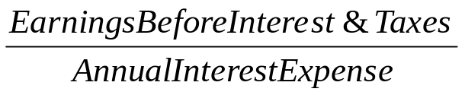
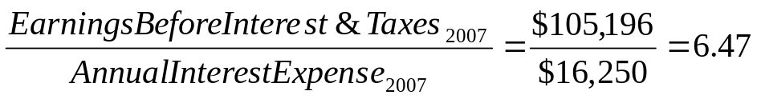
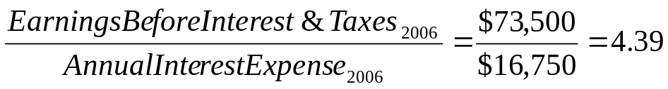
Times Interest Earned (TIE Ratio)
    (1) Calculation
  EBIT divided by annual interest expense
    (2) Interpretation
  Measures firm’s ability to meet interest payments
  Ratio also serves as an indicator of firm’s capacity to take on additional debt
    (3) Cox’s TIE ratios
    (4) Trend Analysis
  Significant improvement from 4.39X in 2006 to 6.47X in 2007
  EBIT increased substantially, and interest expense decreased, from 2006 to 2007
Notes:
And of course, after you know your message and have defined your audiences, you must select the most appropriate medium for delivering the message to each audience.
Internal media, like audiences, come in all shapes, sizes, and flavors.

Slide 26
Profitability Ratios
    Profitability ratios are used to measure the firm’s return on its investments
    Three basic ratios in this category
      (1) Net Profit Margin (NPM)
      (2) Return on Assets (ROA)
      (3) Return on Equity (ROE)
    However, additional analysis of NPM is possible with the following two ratios:
      (1) Gross Profit Margin (GPM)
      (2) Net Operating Profit Margin (NOPM)
Notes:
And of course, after you know your message and have defined your audiences, you must select the most appropriate medium for delivering the message to each audience.
Internal media, like audiences, come in all shapes, sizes, and flavors.

Slide 27
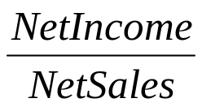
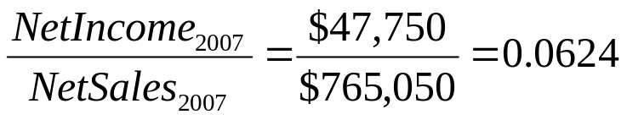
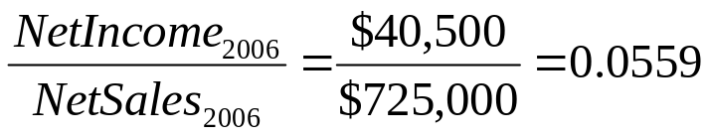
Net Profit Margin
(1) Calculation
  Net income divided by net sales
(2) Interpretation
  Measures the amount of profit per dollar of net sales
  Indicates how well management has controlled total expenses
(3) Cox’s Net profit margin ratios
(4) Trend Analysis
  Increased from 5.59% in 2006 to 6.24% in 2007, indicating management did a better job at controlling expenses in 2007 than in 2006!

Slide 28
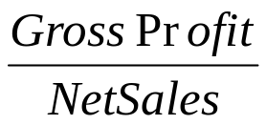
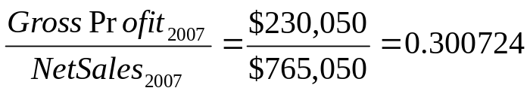

Gross Profit Margin
(1) Calculation
  Gross profit (net sales minus cost of goods sold) divided by net sales
(2) Interpretation
  Measures the amount of direct profit per dollar of net sales
  Indicates how well management has controlled COGS expenses
(3) Cox’s Gross profit margin ratios
(4) Trend Analysis
  Increased from 28.69% in 2006 to 30.07% in 2007, indicating management did a better job at controlling direct expenses in 2007 than in 2006!
    Better job controlling direct labor, direct material, and factory overhead

Slide 29



Net Operating Profit Margin
(1) Calculation
  EBIT (net sales minus COGS minus operating expenses) divided by net sales
(2) Interpretation
  Measures amount of profit per dollar of net sales after direct and indirect costs
  Used in conjunction with GPM to indicates how well management has controlled operating expenses
(3) Cox’s Net operating profit margin ratios
(4) Trend Analysis
  Increased from 10.14% in 2006 to 13.75% in 2007 and, taken together with GPM ratios, indicates management did a better job at controlling operating expenses in 2007 than in 2006!

Slide 30



Return on Assets (ROA)
(1) Calculation
  Net income divided by total assets
(2) Interpretation
  Measures the rate of return on total assets
  Provides a measure for how well management has controlled expenses and/or utilized assets
(3) Cox’s Return on assets ratios
(4) Trend Analysis
  Increased from 6.41% in 2006 to 7.15% in 2007 indicating management improved either the firm’s expense control ratio or the firm’s asset utilization ratio (or both) in 2007 over 2006!

Slide 31



Return on Equity (ROE)
(1) Calculation
  Net income divided by common equity
(2) Interpretation
Measures the rate of return on common shareholders’ investment
Provides a measure for how well management has controlled expenses and/or utilized assets and/or utilized financial leverage
(3) Cox’s Return on equity ratios
(4) Trend Analysis
  Increased from 13.52% in 2006 to 14.04% in 2007 indicating management improved either the firm’s expense control ratio and/or the firm’s asset utilization ratio and/or increased financial leverage in 2007 over 2006!

Slide 32
Cash Flow Ratios
Cash flow ratios measure the coverage and quality of a firm’s cash flows
Two ratios in this category
    (1) Cash Flow Coverage of Interest Expenses
    (2) Quality of Earnings

Slide 33

Cash Flow Coverage of Interest Expenses Ratio
(1) Calculation
  Cash flow from operating activities plus interest expense divided by interest expense
(2) Interpretation
  Measures firm’s ability to meet interest payments from operating cash flow
  Similar to times interest earned (TIE) ratio
(3) Cox’ Cash flow coverage of interest expenses ratios
(4) Trend Analysis
  Not enough data to determine ratio for 2006
  Cox can cover its interest expense 5.6X with cash flow from operations

Slide 34

Quality of Earnings Ratio
(1) Calculation
  Cash flow from operating activities minus preferred dividends divided by earnings available for common shareholders
(2) Interpretation
  Measures the amount of cash flow per dollar of earnings available to common shareholders
  Higher ratio indicates greater strength of firm in terms of its cash flow
(3) Cox’ Quality of earnings ratio
(4) Trend Analysis
  Not enough data to determine ratio for 2006
  Cox generates $1.57 in operating cash flow available to common shareholders per each dollar of accounting earnings available to common

Slide 35
Du Pont Analysis
Provides useful framework to analyze a firm’s financial statements using ratio and trend analyses
Decomposes a firm’s ROE into three parts
  Expense Control: Profit margin
  Asset Utilization: Total asset turnover
  Financial Leverage: Leverage Multiplier
Illustrates management’s abilities to…
  Control expenditure based on analysis of profit margin
  Utilize assets efficiently based on analysis of asset turnover

Slide 36


ROE
ROA x LM
NPM x TAT
GPM Inv Turns
NOPM A/R Turns
FAT

Slide 37



ROE
ROA x LM
NOPM x TAT
Inv Turns
A/R Turns
FAT

Slide 38
Cox Oil Company, Inc.
Du Pont Analysis
ROE
2007 2006
14.04% 13.52%
ROA x LM
2007 2006 2007 2006
7.15% 6.41% 1.964X 2.109X
NPM x TAT
2007 2006 2007 2006
6.24% 5.59% 1.145X 1.148X
GPM Inv Turns
30.07% 28.69% 2.97X 2.79X
NOPM A/R Turns
13.75% 10.14% 4.90X 5.00X
FAT
5.10X 6.06X

Slide 39
What do you think of Cox Oil Company, Inc.?
Positives
  (1) Profit Margin Improvements from 2006 to 2007
    Trends in NPM, GPM, and NOPM improved
  (2) Asset Utilization Improvements from 2006 to 2007
    Trends in inventory and total long-term asset turnovers improved
  (3) Financial Leverage Improvement from 2006 to 2007
    Trend in LM improved (i.e., Cox de-levered)
  (4) ROE trend improved from 2006 to 2007
  Negative
  (1) Asset Utilization Declines from 2006 to 2007
    Trends in TAT, A/R turnover, and FAT decreased

Slide 40
So, what do you think of Cox Oil Company, Inc.?
Would you invest in Cox Oil Company, Inc.?

Slide 41
Comparative Analyses
Comparative analyses enable financial managers to compare a company with either another company or the industry as a whole
Two types of comparative analyses
  (1) Common-Size Analysis: to compare one company to another
  (2) Industry Comparison Analysis: to compare a company to the industry average

Slide 42
Common-Size Analysis
Useful way of standardizing financial statements to make one comparable to another
Common-Sized Balance Sheet: Express each item on the balance sheet as a percentage of total assets
    Divide each item on the balance sheet by the dollar amount of total assets and multiply by 100
Common-Sized Income Statement: Express each item on the income statement as a percentage of net sales
    Divide each item on the income statement by the dollar amount of net sales and multiply by 100

Slide 43
Cox Oil Company, Inc.
Common-Sized Consolidated Balance Sheet
December 31
Assets 2007 % 2006 %
Current Assets:
Cash and cash equivalents $ 19,500 2.92% $ 15,000 2.37%
Marketable securities 46,300 6.93% 32,000 5.07%
Accounts receivable (net) 156,000 23.35% 145,000 22.96%
Inventories 180,000 26.94% 185,000 29.29%
Prepaid expenses and other current assets 4,000 0.60% 3,000 0.47%
Total current assets 405,800 60.74% 380,000 60.16%
Long-Term Assets:
Gross property, plant and equipment 185,000 27.69% 146,600 23.21%
Less: accumulated depreciation 35,000 5.24% 27,000 4.27%
Net property, plant and equipment 150,000 22.45% 119,600 18.94%
Gross reserves 200,000 29.94% 200,000 31.66%
Less: accumulated depletion 90,000 13.47% 70,000 11.08%
Net reserves 110,000 16.47% 130,000 20.58%
Total long-term assets (net) 260,000 38.92% 249,600 39.52%
Other Assets:
Gross intangibles (goodwill, patents) 2,250 0.34% 2,250 0.36%
Less: accumulated amortization 300 0.04% 250 0.04%
Net intangibles 1,950 0.30% 2,000 0.32%
Investment securities (at cost) 300 0.04% - 0.00%
Total other assets (net) 2,250 0.34% 2,000 0.32%
Total Assets $668,050 100.00% $631,600 100.00%

Slide 44
Liabilities and Shareholders’ Equity 2007 % 2006 %
Current Liabilities:
Accounts payable $ 60,000 8.98% $ 57,000 9.03%
Notes payable 51,000 7.63% 61,000 9.66%
Accrued expenses 30,000 4.49% 36,000 5.70%
Income taxes payable 17,000 2.55% 15,000 2.37%
Other current liabilities 12,000 1.80% 12,000 1.90%
Current portion of long-term debt 6,000 0.90% - 0.00%
Total current liabilities 176,000 26.35% 181,000 28.66%
Long-Term Liabilities:
Deferred income taxes 16,000 2.39% 9,000 1.43%
9.12% debenture payable 2010 130,000 19.46% 130,000 20.58%
Other long-term debt - 0.00% 6,000 0.95%
Total Liabilities 322,000 48.20% 326,000 51.62%
Shareholders’ Equity:
Preferred stock, $5.83 cumulative, $100 par 6,000 0.90% 6,000 0.95%
Common stock, $5.00 par 75,000 11.23% 72,500 11.48%
Additional paid-in capital 20,000 2.99% 13,500 2.14%
Retained earnings 249,000 37.27% 219,600 34.77%
Foreign currency translation adjustment (net) 1,000 0.15% (1,000) (0.16%)
Unrealized gain available-for-sale securities (net) 50 0.01% - 0.00%
Less: Treasury stock at cost (5,000) (0.75%) (5,000) (0.79%)
Total Shareholders’ Equity 346,050 51.80% 305,600 48.39%
Total Liabilities and Shareholders’ Equity $668,050 100.00% $631,600 100.00%

Slide 45
Cox Oil Company, Inc.
Common-Sized Consolidated Income Statement
January 1 through December 31
(Dollars in Thousands, Except Per-Share Amounts)
2007 % 2006 %
Net sales $765,050 100.00% $725,000 100.00%
Cost of goods sold 535,000 69.93% 517,000 71.31%
Gross Profit 230,050 30.07% 208,000 28.69%
Operating expenses:
Selling, general and administrative expenses 96,804 12.65% 109,500 15.10%
Depreciation, depletion and amortization 28,050 3.67% 25,000 3.45%
Earnings before interest and taxes (EBIT) 105,196 13.75% 73,500 10.14%
Interest Expense 16,250 2.12% 16,750 2.31%
Dividend and interest income 5,250 0.68% 10,000 1.38%
Earnings before taxes and extraordinary items 94,196 12.31% 66,750 9.21%
Income tax 41,446 5.42% 26,250 3.62%
Earnings before extraordinary items 52,750 6.89% 40,500 5.59%
Extraordinary item: Loss on earthquake (5,000) (0.65%) - 0.00%
Net income $ 47,750 6.24% $ 40,500 5.59%
EPS before extraordinary item $ 3.55 $ 2.77
Earnings per share – extraordinary item (0.34) -
Net income per common share $ 3.21 $ 2.77

Slide 46
Industry Comparison Analysis
RMA Annual Statement Studies
  Best industry comparison benchmark for small and middle-market companies
  Unfortunately, not available in an online form through SMU
Standard & Poor’s Industry Surveys
  Good industry comparison benchmark for large, publicly-traded companies
  Available online through SMU’s Library
Use Du Pont Analysis for comparison…

Slide 47
ROE
Cox S&P
2006 2006
13.52% 27.24%
ROA x LM
Cox S&P Cox S&P
2006 2006 2006 2006
6.41% 13.33% 2.109X 1.166X
NPM x TAT
Cox S&P Cox S&P
2006 2006 2006 2006
5.59% 10.60% 1.148X 1.258X

Slide 48
Done!
Now what do you think of Cox Oil Company Inc.?

Slide 49
Thank you
Thank You!
Charles B. (Chip) Ruscher, PhD
Department of Finance and Business Economics

